Slide 1

Elastic Load Balancing & Auto Scaling
Distribute the load and auto scale the servers

Slide 2
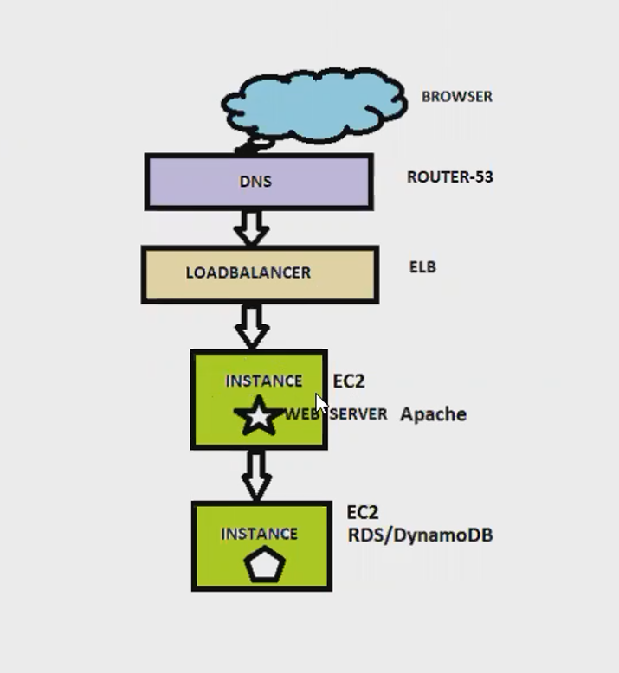
Flow Diagram

Slide 3
Scalability:
Scalability means than an application/System/Server can handle greater loads by adapting to the current demand.

Slide 4
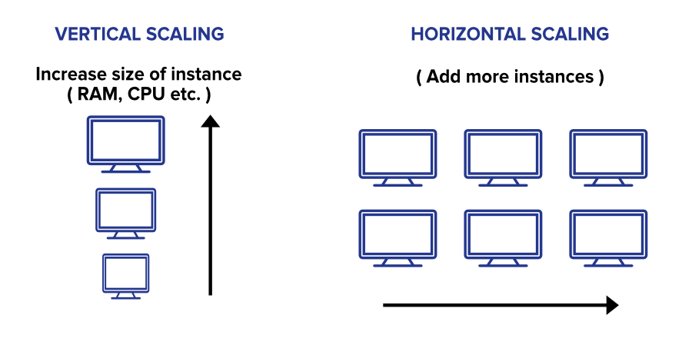
Type of Scalability:
Vertical Scaling
Horizontal Scaling (Elastic)

Slide 5
Vertical Scaling
Vertical Scaling means increasing the size of the instance.
Fox example, your application runs on t2.micro then scaling that application vertically means running it on t2.large.

Slide 6


Vertical Scaling
Junior Operator
Senior Operator

Slide 7
Horizontal Scaling
Horizontal Scalability means increasing the number of the instance/server for your application.

Slide 8

Horizontal Scaling
Operators:-

Slide 9
Load Balancers
Load balancers are servers that forwards internet traffic to multiple servers (EC2 Instances) downstream

Slide 10


USER 1

Slide 11
USER 1
USER 2

Slide 12
USER 1
USER 2
USER 3

